Slide 2


Every app trick in the book
Ian Barker
Embarcadero Delphi MVP
ian.barker@gmail.com
@punctuation
about.me/IanBarker
Slides, link & replay https://tinyurl.com/everyapptrick

Slide 3
All the things you know you should be doing …and some you didn’t think you could
Every app trick in the book

Slide 4
 Themes and styles  Detecting dark mode (and reacting when it changes)  Showing web pages (local and remote)  Checking for updates  In-app scripting  Single instance  Manipulating images  To the web!  Let's Encrypt components  Reverse proxy via NGINX  ...and beyond!
Every app trick in the book
 Alerts  Notifications  Elevation button
 Launching things
 Settings persistence  Reading and writing safely  User authentication OAUTH2  User biometrics – the NEW TBiometricAuth component  Check for an internet connection  Splash screens  Adding some coolness

Slide 5
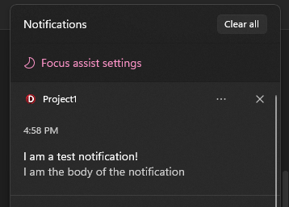
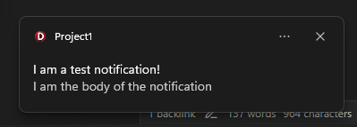
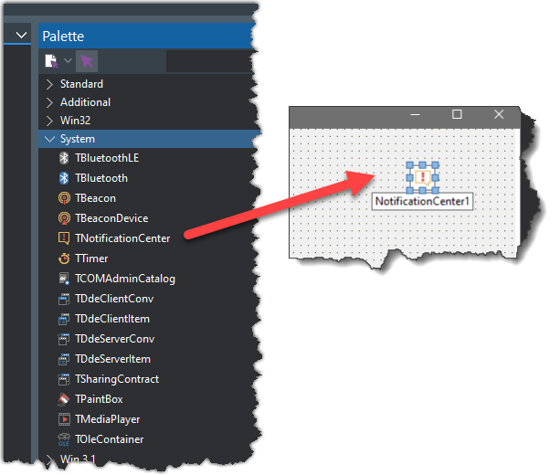
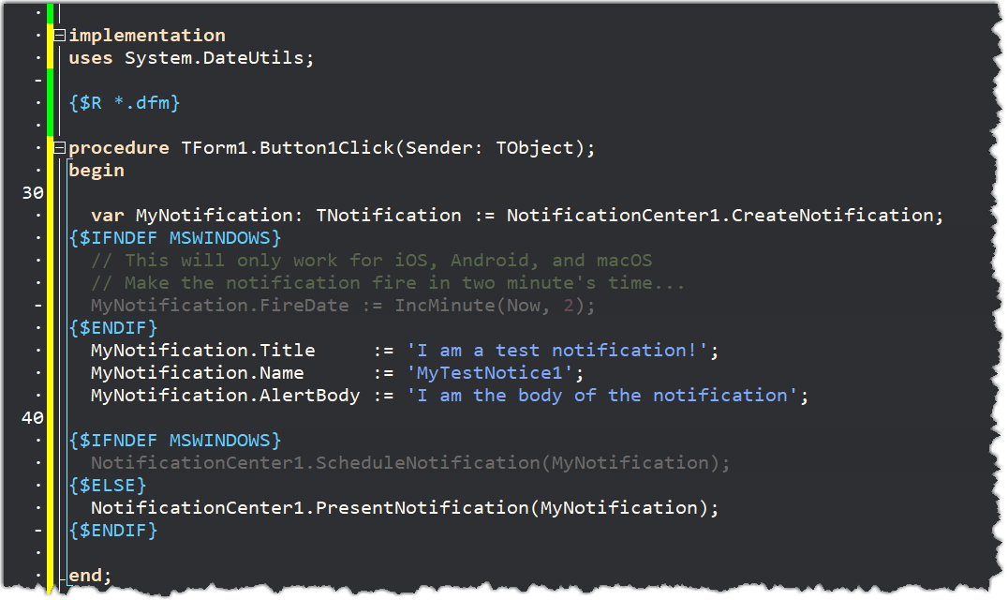
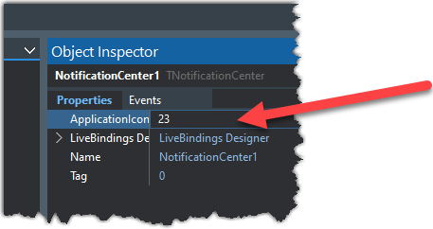
Notifications
For iOS and Android icon badges use the ApplicationIcon property

Slide 6
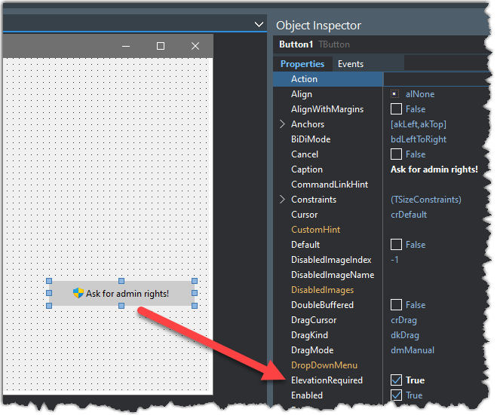
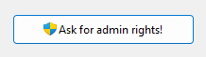
Elevation Button
Only works on Windows using the VCL
Shows the Windows elevation icon
Use it for something which will require the user to enter additional user authentication such as an admin password

Slide 7
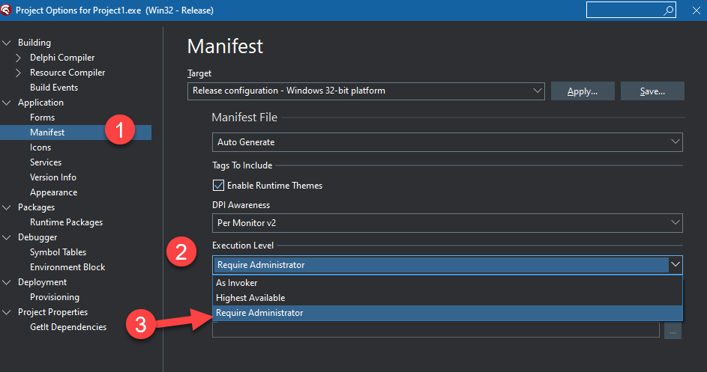
Elevation Button
To actually make your app run as administrator
Go to project, options
Select “manifest”
Select “execution level”
Choose “require administrator”

Slide 8
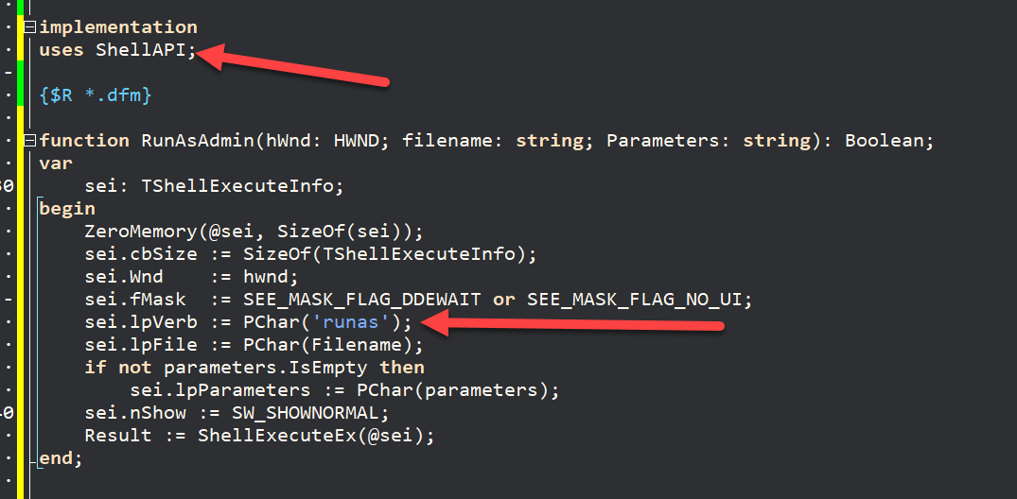
Elevation Button
To launch or relaunch an app as administrator
https://learn.microsoft.com/en-us/windows/win32/shell/launch

Slide 9
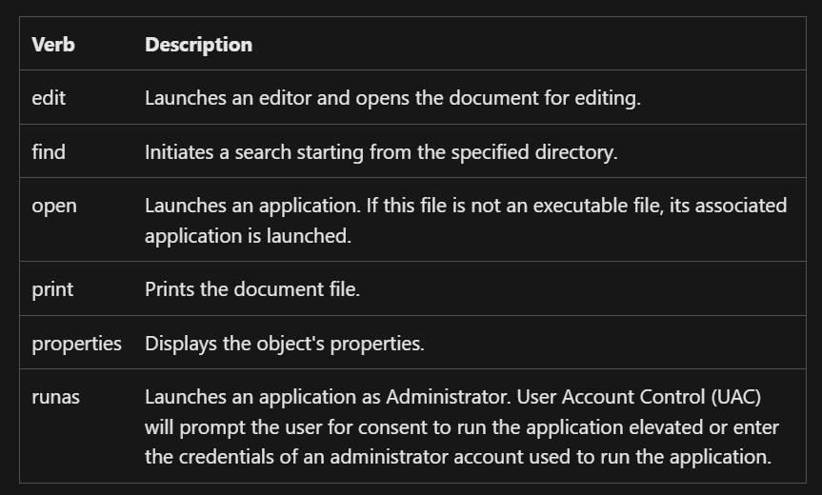
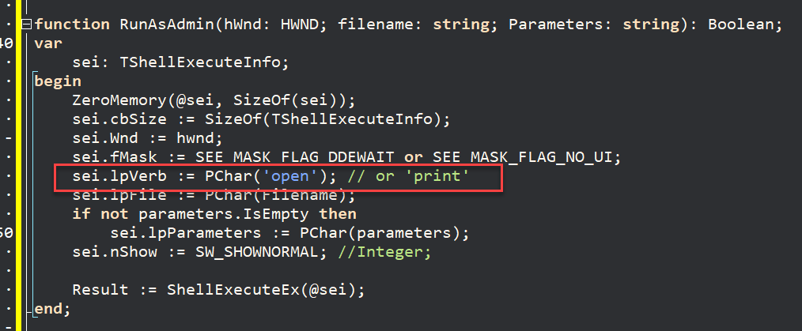
Launching things
https://learn.microsoft.com/en-us/windows/win32/shell/launch

Slide 10
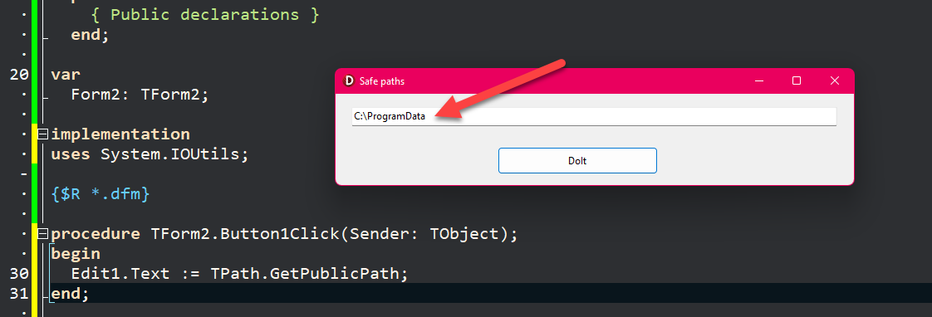
Settings Persistence
“Why can’t I just use the registry?”
Saving in the registry will not work cross-platform
In many corporate environments much of the registry is either set to read-only or is volatile (reset) after the session ends
https://docwiki.embarcadero.com/Libraries/Alexandria/en/System.IOUtils.TPath

Slide 11
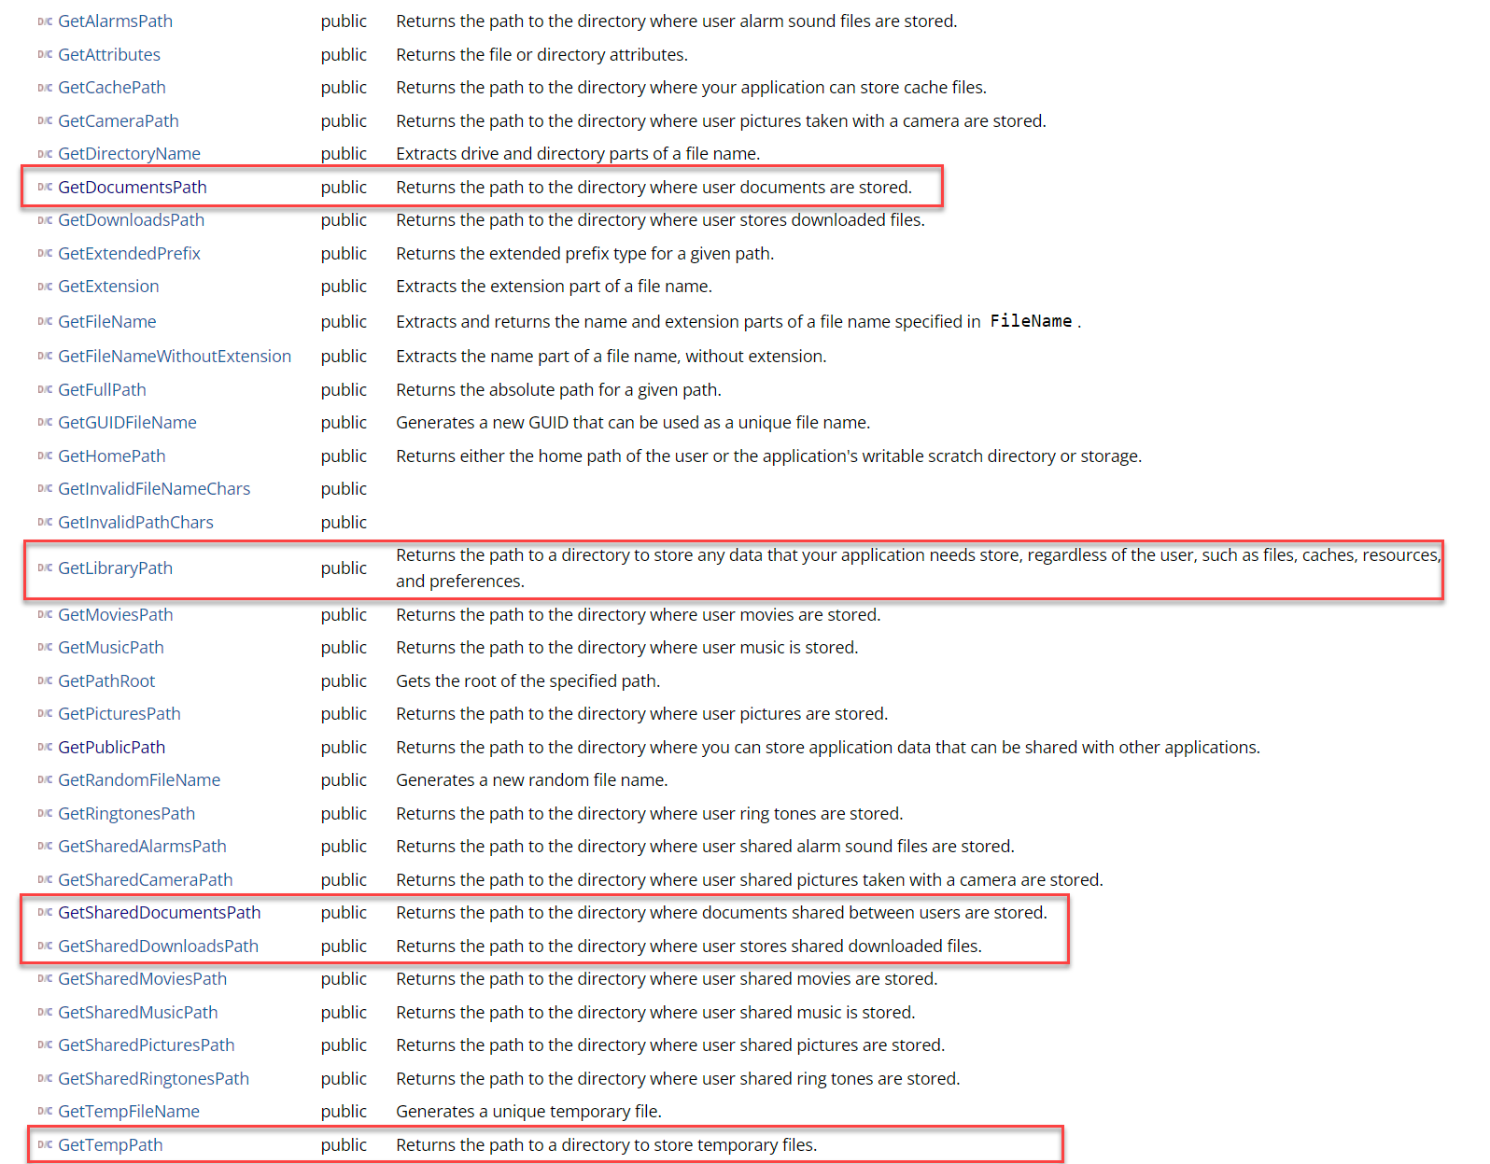
Reading and writing safely
TPath works cross platform for VCL and FMX
Don’t use SHGetFolderPath since it is Windows-specific
TPath is the only safe way

Slide 12
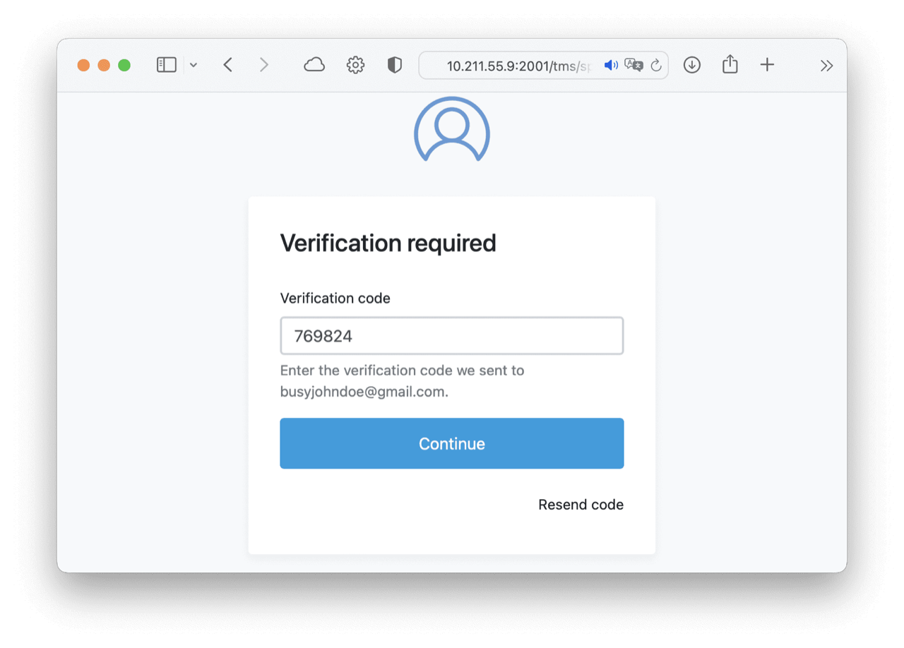
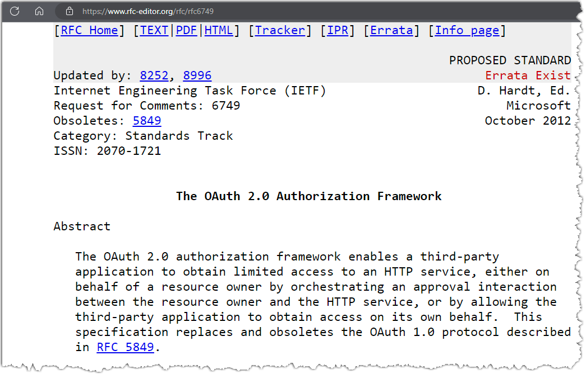
User authentication OAUTH2
OAUTH2 is a standard for user authentication
Many big service providers are moving or have moved to OAUTH2 for things like third-party app authentication
In principle it’s easy to use
In practice it’s a nightmare to get right!
Verification image courtesy of TMS Software
Notes:
Amazon Cognito

Slide 13
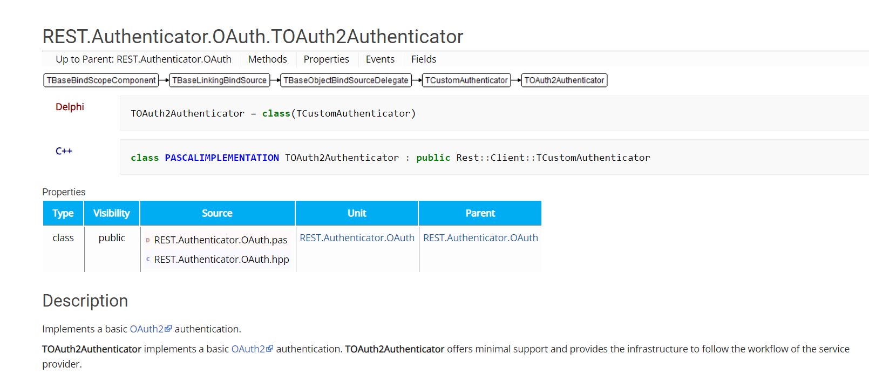
User authentication OAUTH2
The built-in REST components and framework support OAUTH2
I found this… tricky..

Slide 14
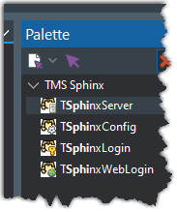
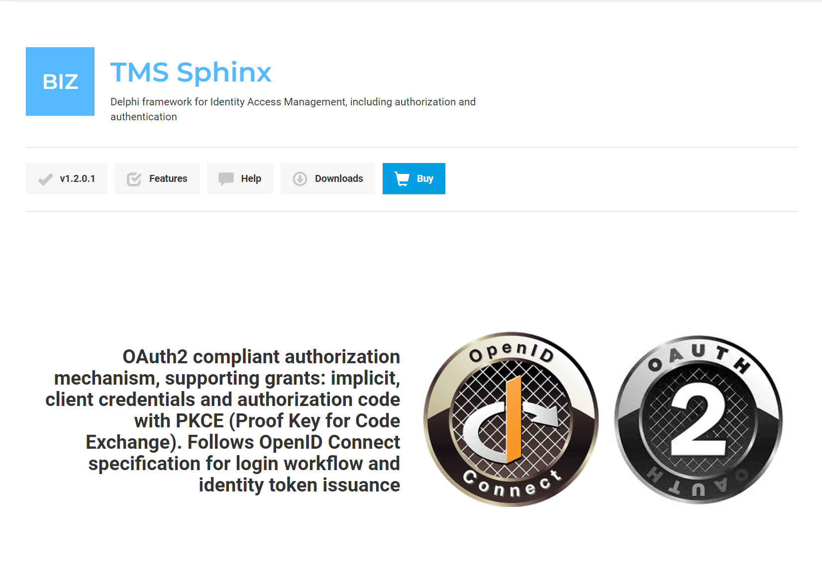
User authentication OAUTH2
Tech Partner TMS Software have a superb product called Sphinx which implements OAUTH2
It has client and server components so you can easily implement your own OAUTH2 server and client apps
https://www.tmssoftware.com/site/sphinx.asp

Slide 15
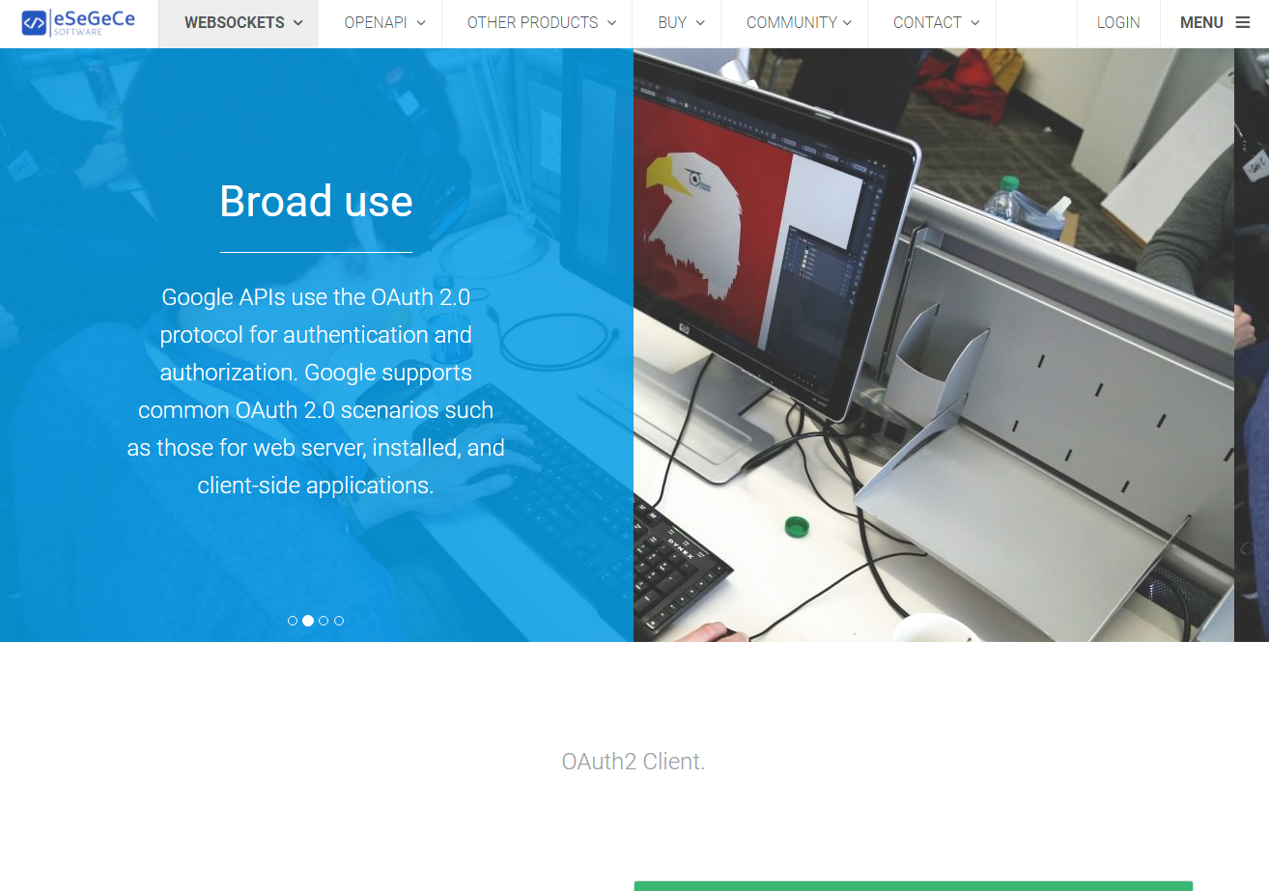
User authentication OAUTH2
eSeGeCe support OAUTH2 as part of their sgcWebSockets product
There are client and server components
Note there are different prices and to get the server you need the ‘Enterprise’ level
https://www.esegece.com/websockets/http/oauth2

Slide 16
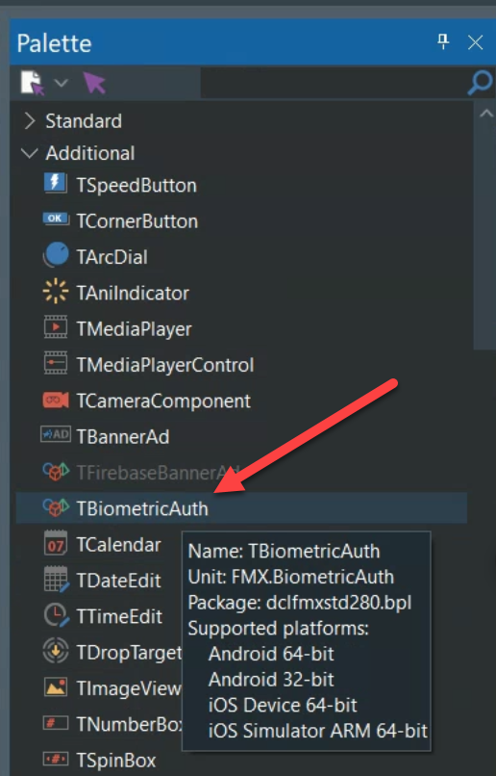
User biometrics – the NEW TBiometricAuth component
A really great new component has been added in the upcoming RAD Studio 11.3
It is the TBiometricAuth component which makes the implementation of biometric authentication of app users on Android and iOS REALLY easy!
NOTE: This is an 11.3 Malawi beta feature covered with permission from Embarcadero. Unreleased features are not committed until GA

Slide 17
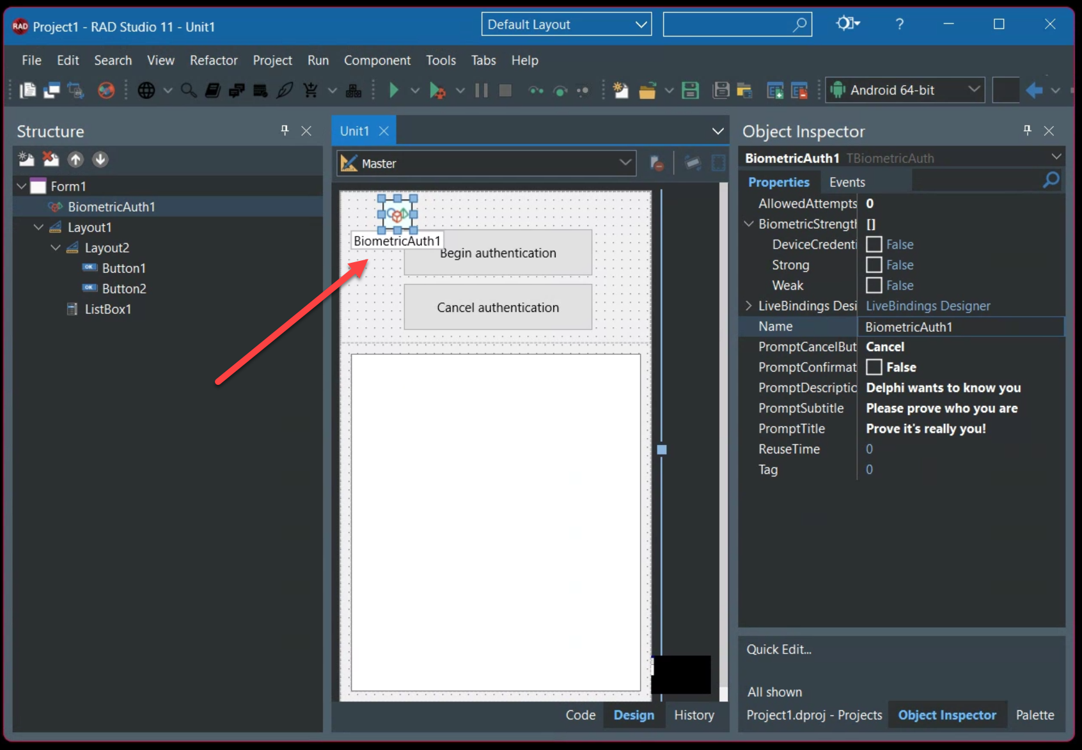
User biometrics – the NEW TBiometricAuth component
Find TBiometricAuth on the “additional” section of the component pallette
Drop it on your FMX form
Set the prompt details and choose the Biometric Strength
NOTE: This is an 11.3 Malawi beta feature covered with permission from Embarcadero. Unreleased features are not committed until GA

Slide 18
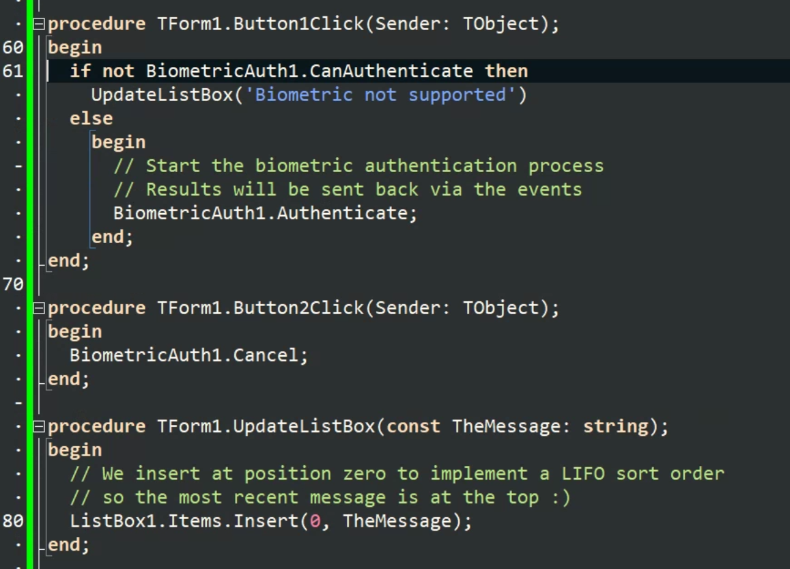
User biometrics – the NEW TBiometricAuth component
It has two main methods
Authenticate starts the process and makes the device show the biometric authentication prompt
Cancel allows you to clear the biometric authentication prompt
NOTE: This is an 11.3 Malawi beta feature covered with permission from Embarcadero. Unreleased features are not committed until GA

Slide 19
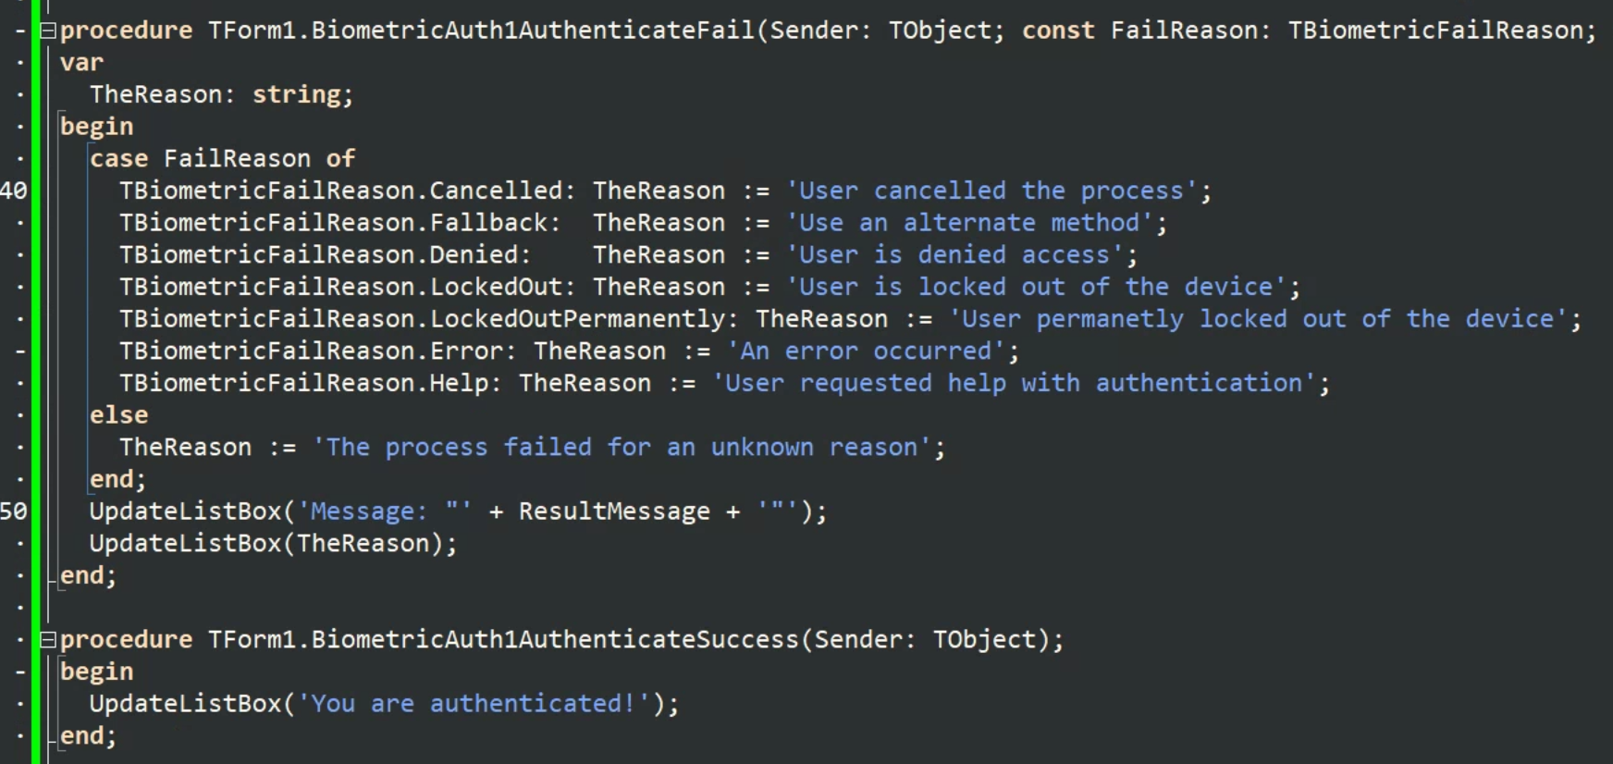
User biometrics – the NEW TBiometricAuth component
It has two events
AuthenticateFail triggered when it.. fails..
For a variety of reasons
AuthenticateSuccess The person using the device is an authorized user
NOTE: This is an 11.3 Malawi beta feature covered with permission from Embarcadero. Unreleased features are not committed until GA

Slide 20
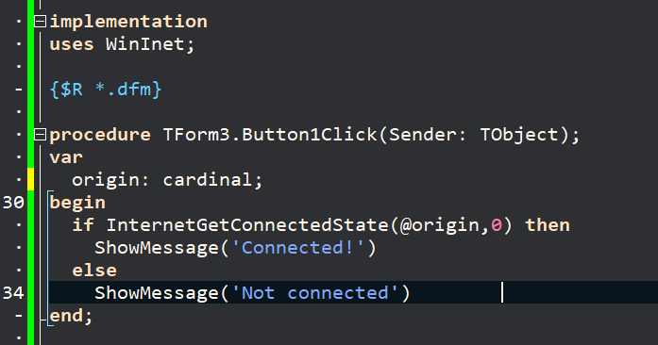
Check for an internet connection
This seems to come up a lot
How to check for an internet connection – Windows only
The other method is to try connecting to Google

Slide 21
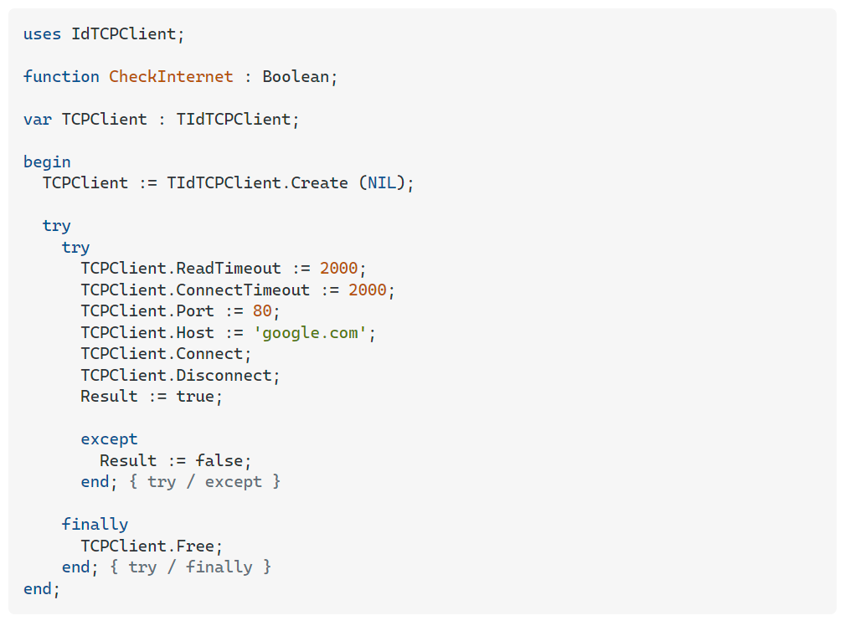
Check for an internet connection
The other method is to try connecting to Google
(if Google is down, the apocalypse has probably begun)
See the excellent FMXexpress.com
http://www.fmxexpress.com/must-have-check-network-connectivity-state-library-for-delphi-xe8-firemonkey-on-android-and-ios/
And Dave Nottage’s DelphiWorlds
https://delphiworlds.com/2018/07/connectivity-checker-for-mobile-revisited/

Slide 22
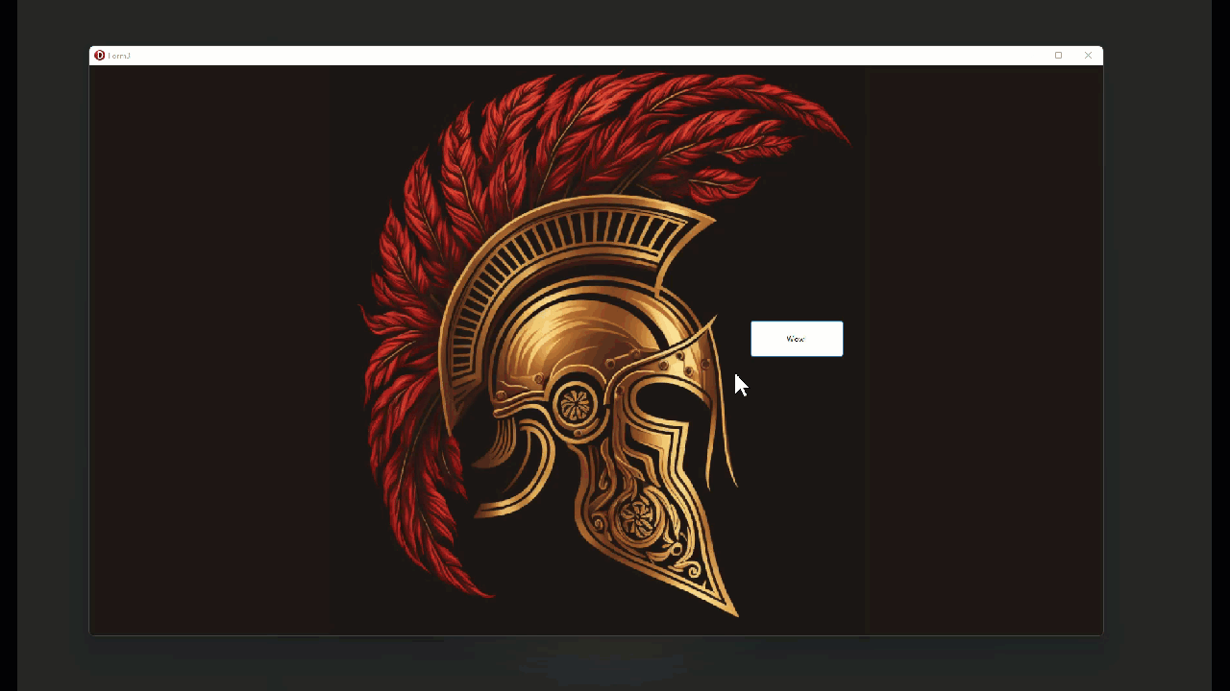
Splash screens

Slide 23
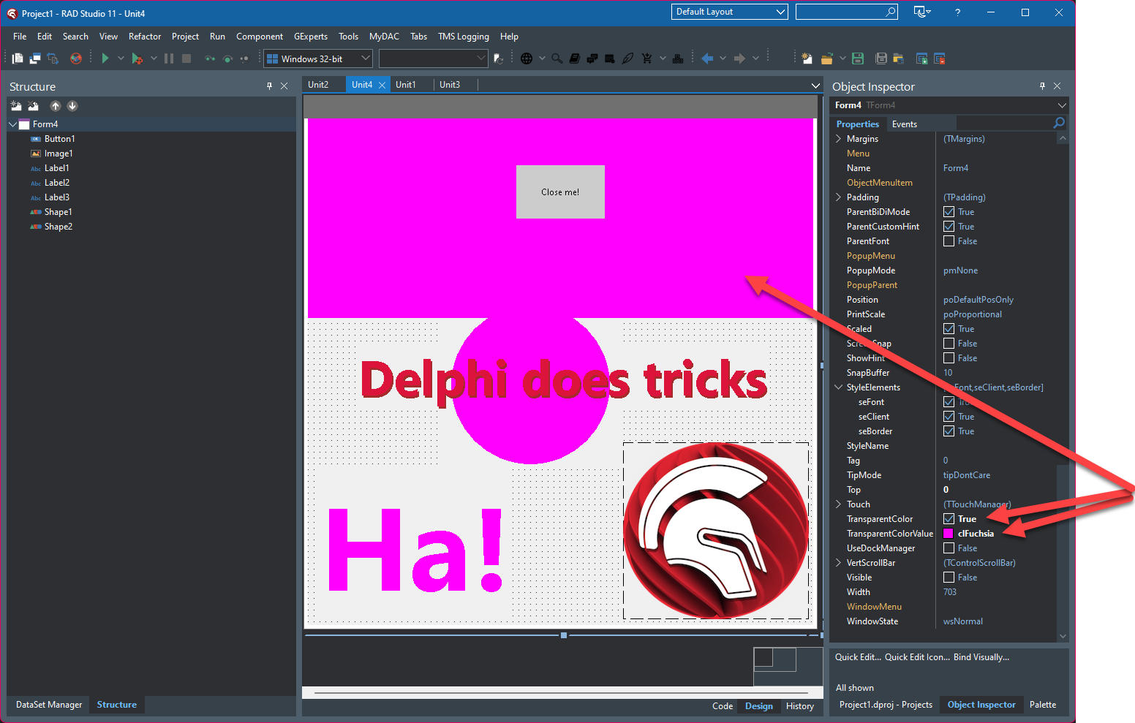
Splash screens
Set the transparent color to clFuchsia
Then anything on the form painted in fuchsia is transparent

Slide 24
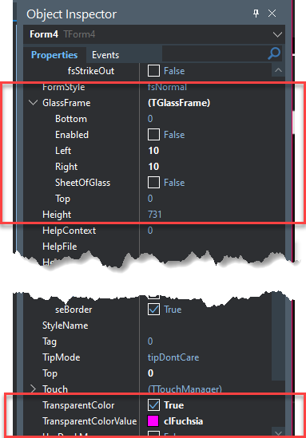
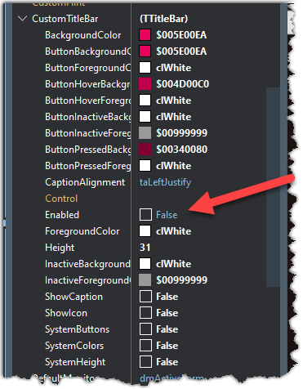
Splash screens
You can’t use this trick if you use the GlassFrame feature
It also will not work if you turn on the CustomTitleBar properties

Slide 25
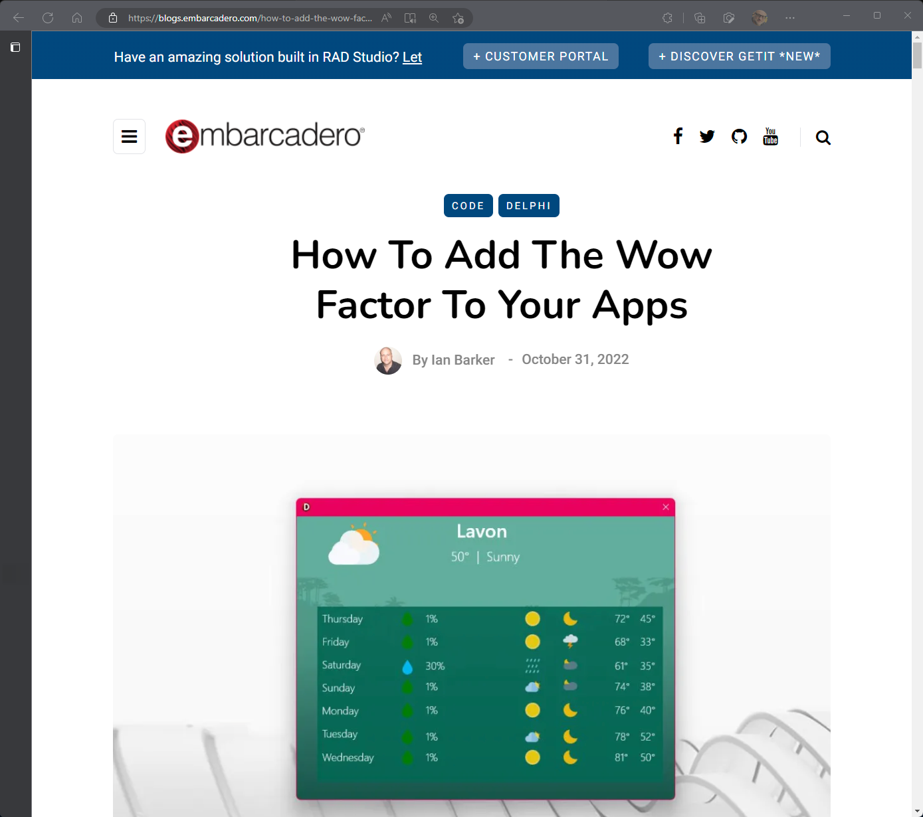
Adding some coolness
Visit the main Embarcadero blog
http://tinyurl.com/delphiwowfactor

Slide 26
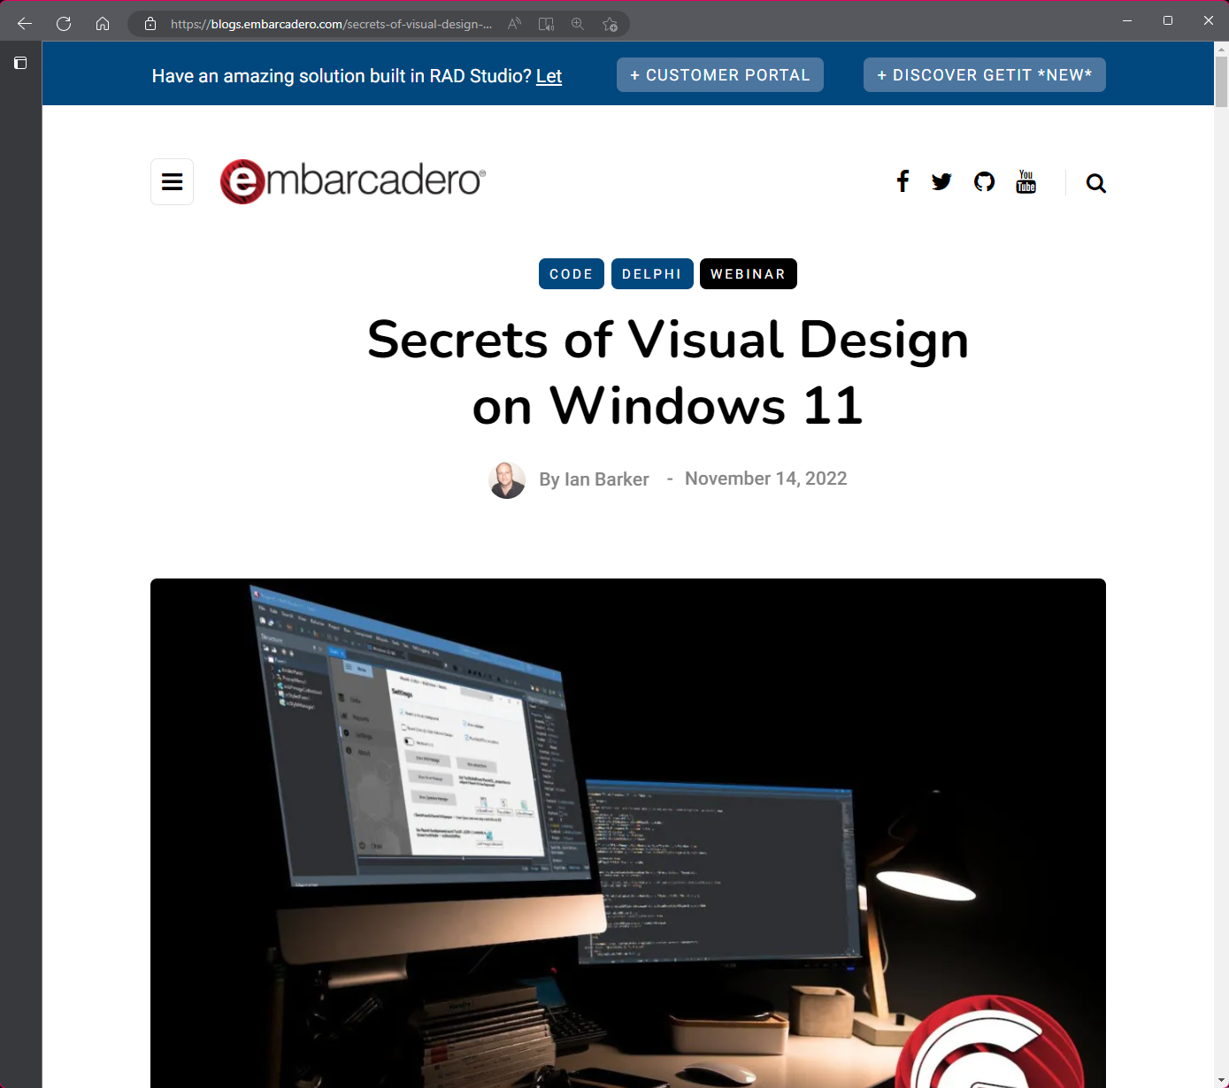
Themes and styles
Visit the main Embarcadero blog
http://tinyurl.com/delphiw11design

Slide 27
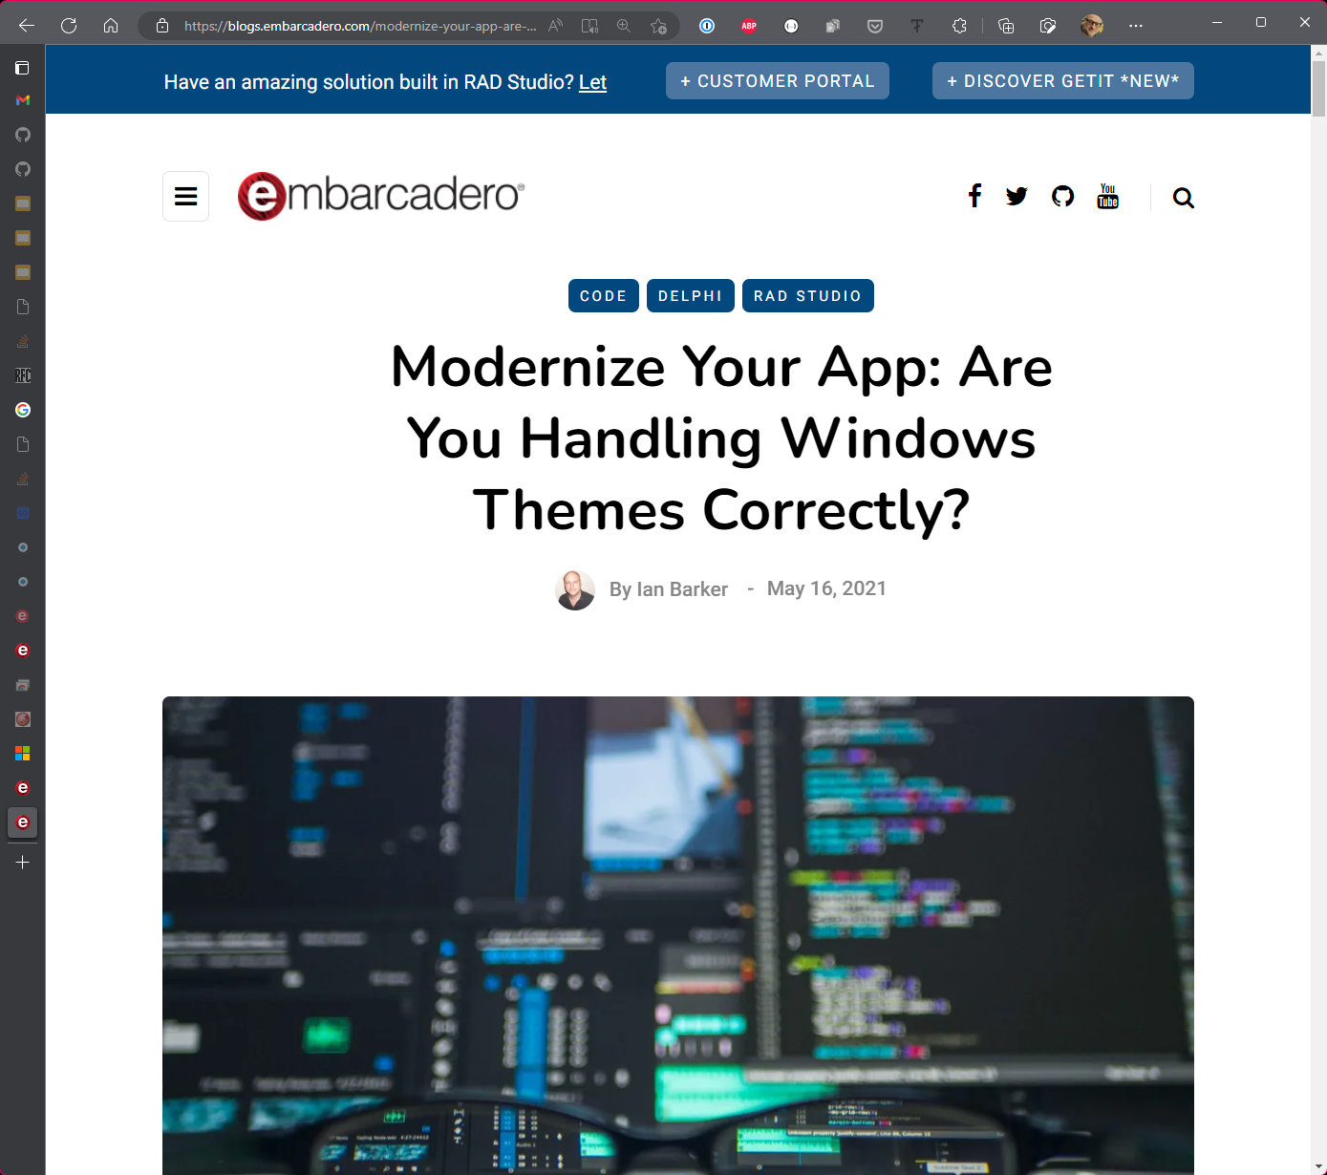
Detecting dark mode (and reacting when it changes)
Visit the main Embarcadero blog
https://blogs.embarcadero.com/modernize-your-app-are-you-handling-windows-themes-correctly/

Slide 28
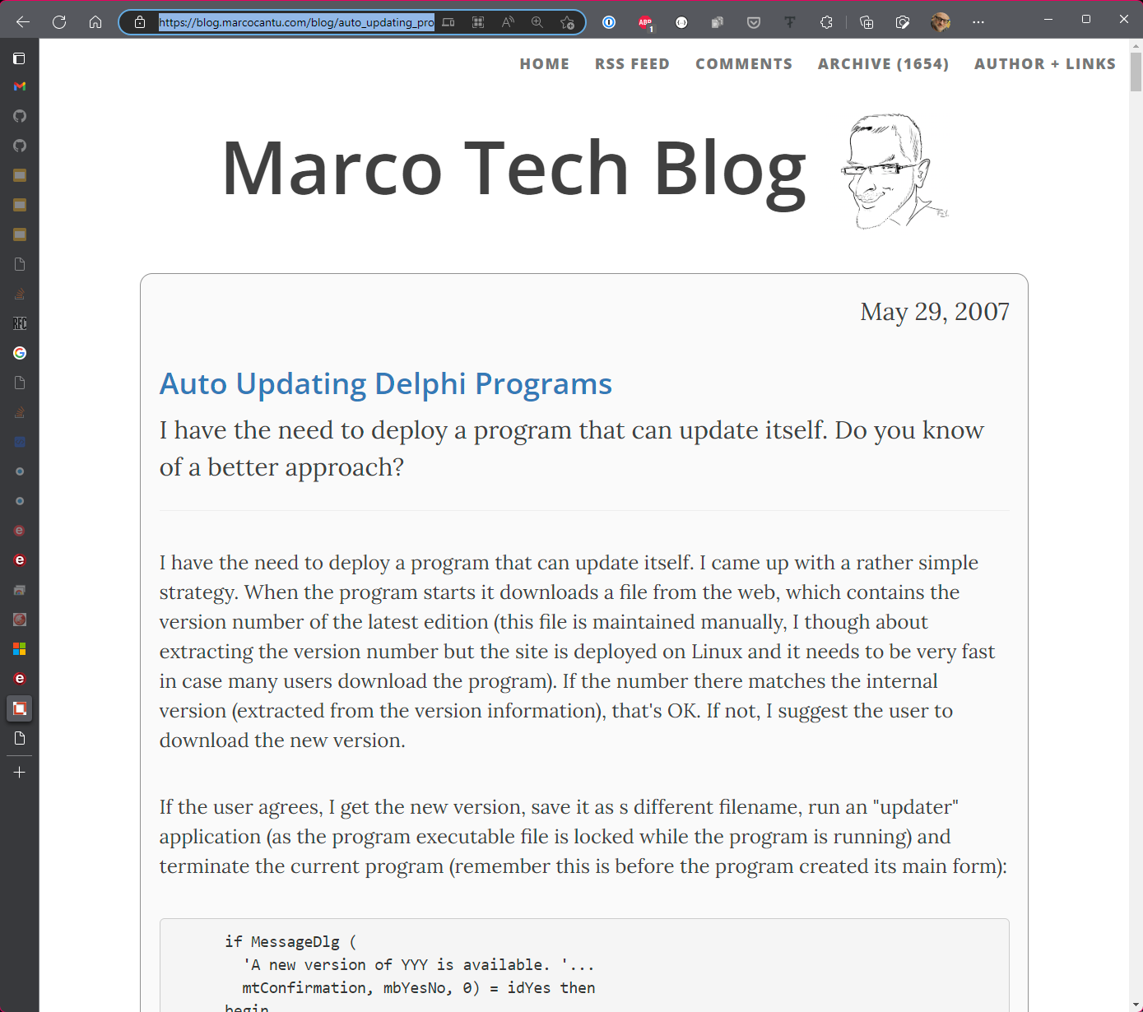
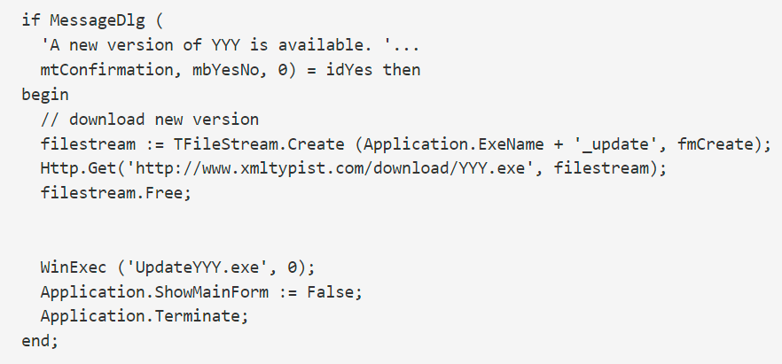
Checking for updates
Marco has a (very old) blog entry
https://blog.marcocantu.com/blog/auto_updating_programs.html

Slide 29
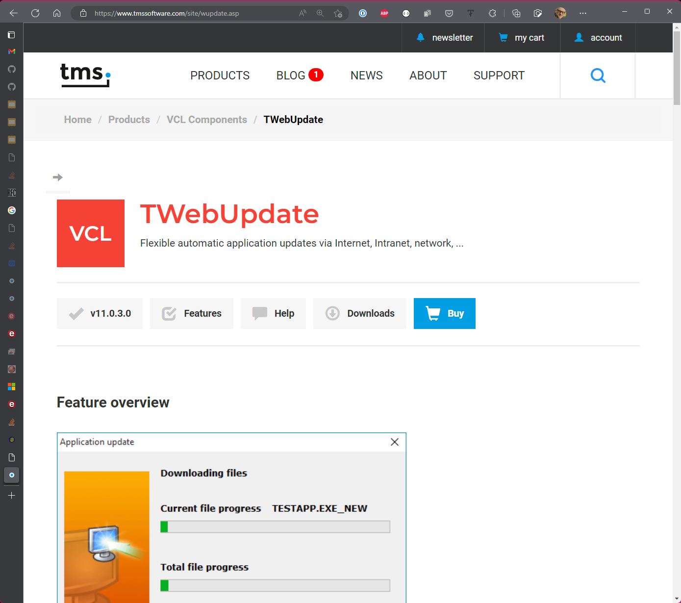
Checking for updates
Components for auto updates
The one I use is TWebUpdate from TMS Software
A great video about it is on MVP Holger Flick’s site
https://flixengineering.com/archives/1615
Be careful if you Google for Delphi auto update components – there appear to be some virus-infected sites offering things, especially TmxWebUpdate

Slide 30
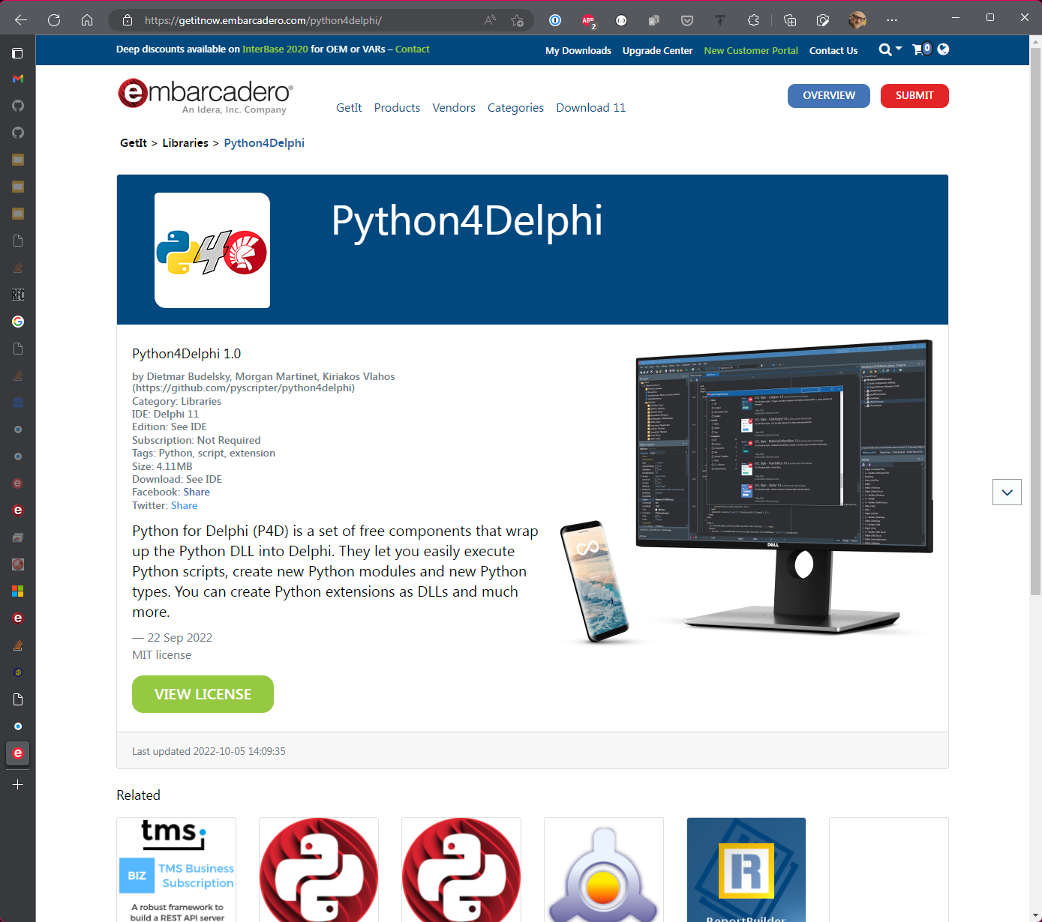
In-app scripting
Python4Delphi is the new unparalleled power-house for in-app scripting
It’s available on GetIt or download it directly from GitHub
https://github.com/pyscripter/python4delphi

Slide 31
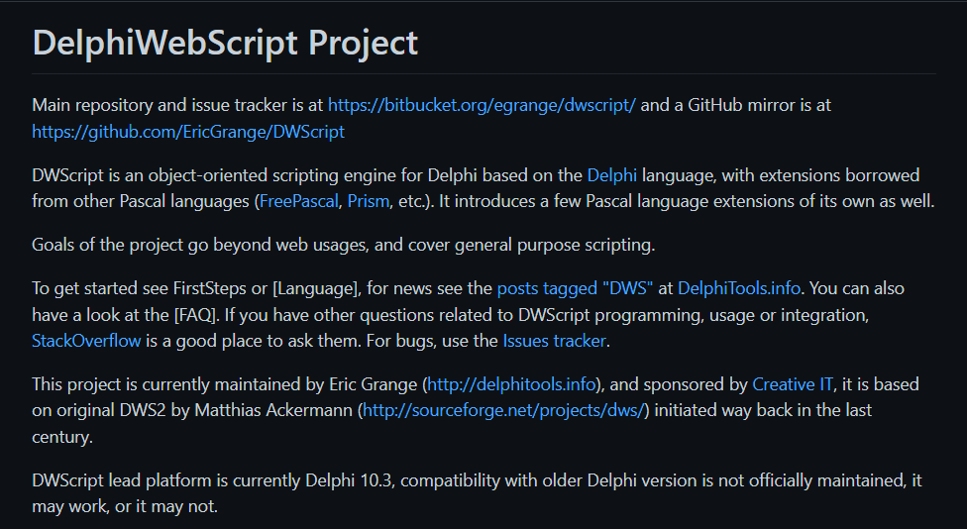
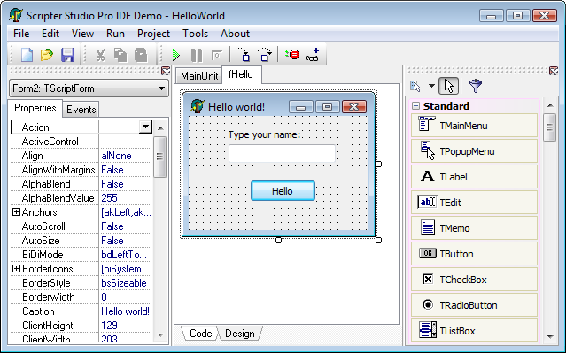
In-app scripting
TMS Scripter
https://www.tmssoftware.com/site/scriptstudiopro.asp
DWScript by Eric Grange
https://github.com/EricGrange/DWScript

Slide 32
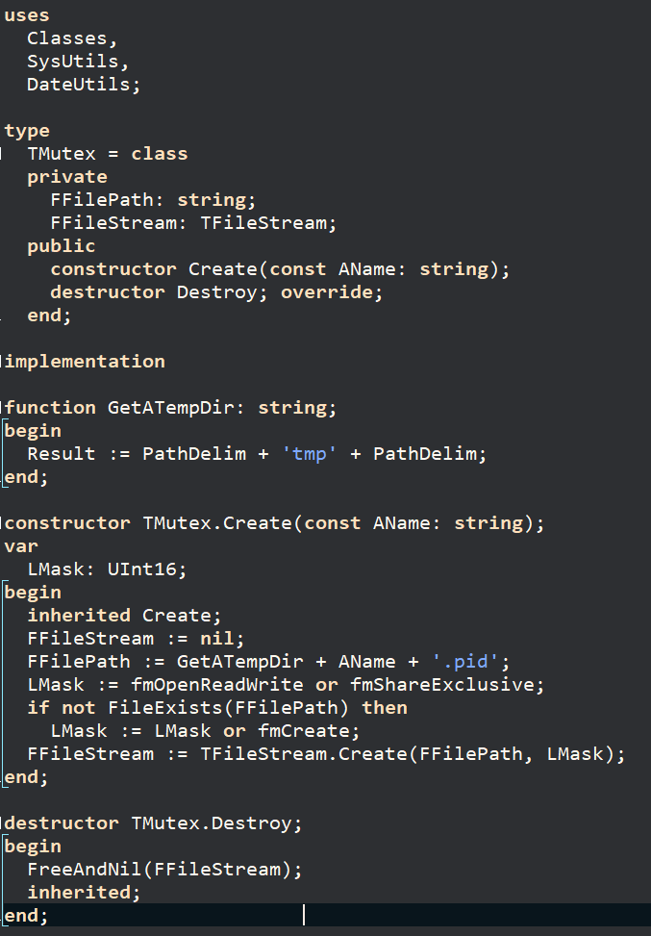
Single instance
There are a few components around which prevent your app from being run more than once.
But almost all are Windows-only
Here’s a Stack Overflow solution for all operating systems (I tweaked it to fix the hard-coded path in the original answer)
https://stackoverflow.com/questions/73023379/run-only-a-single-instance-of-my-application-on-linux

Slide 33
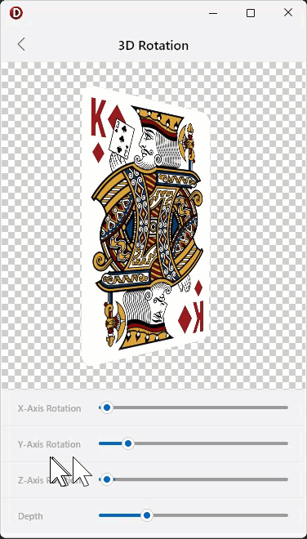
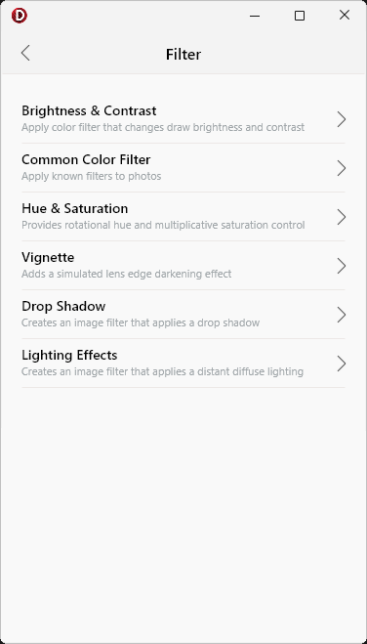

Manipulating images
A very easy choice!
skia4delphi.org

Slide 34

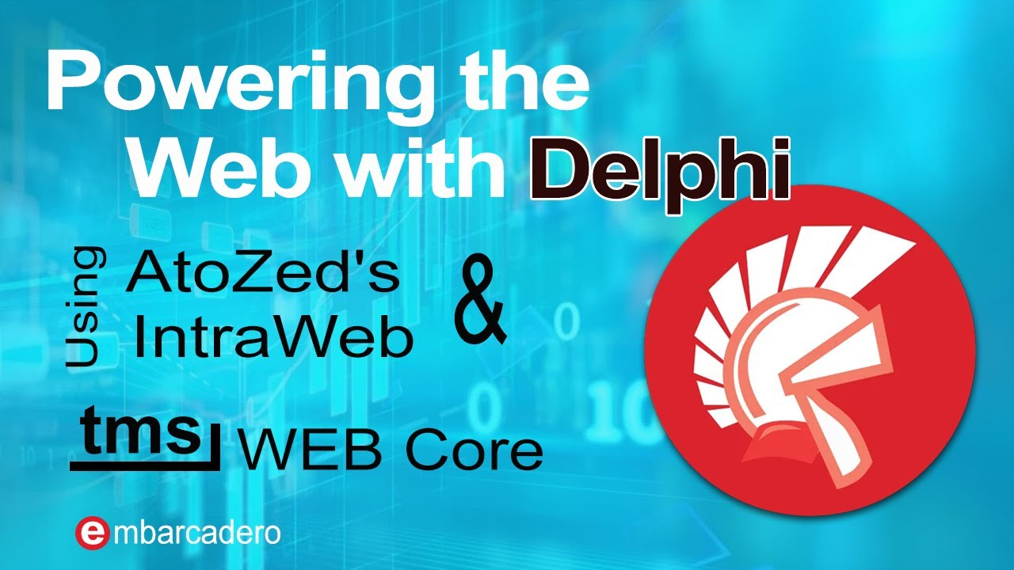
To the web!
https://youtu.be/otIz4XHMnl0
https://youtu.be/fN4m-a-C64o
https://www.youtube.com/@EmbarcaderoTech

Slide 35
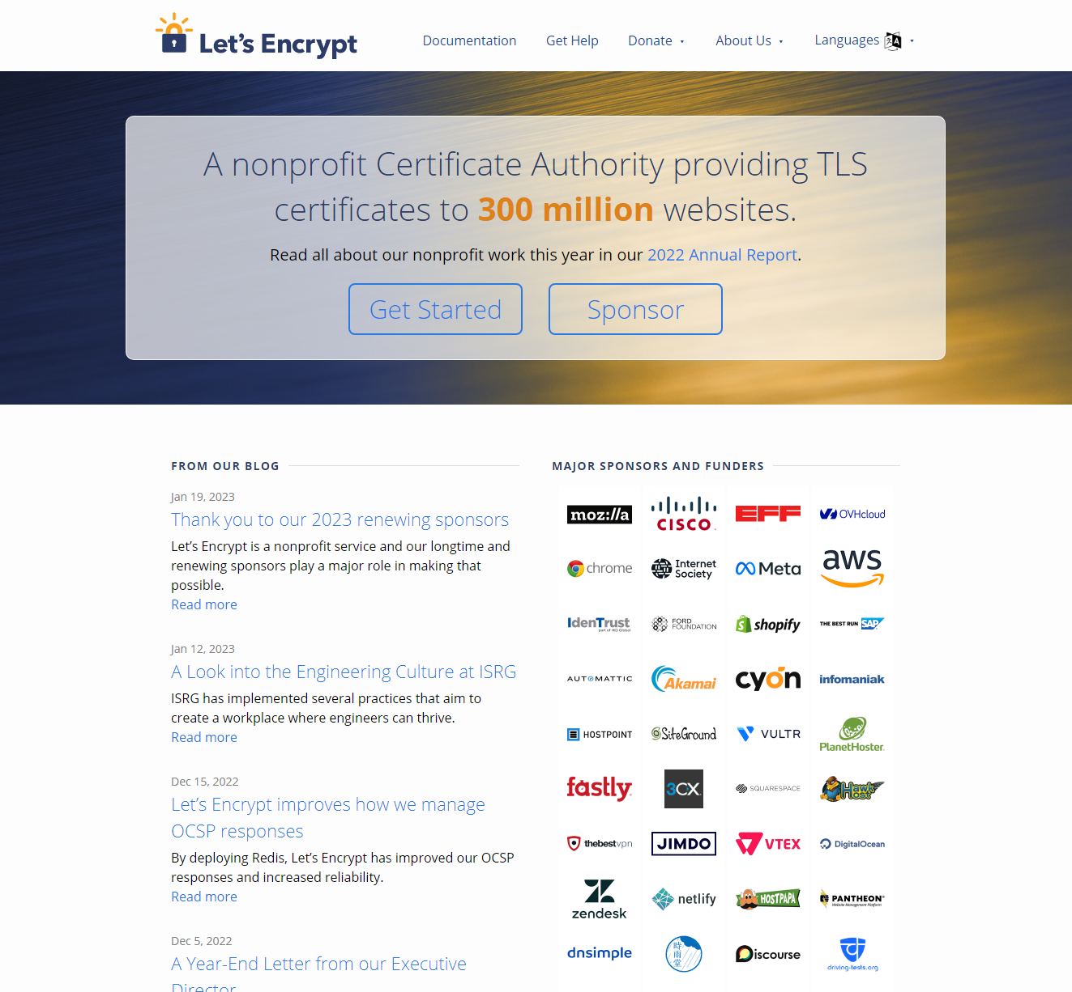
Let’s Encrypt – free SSL certificates!
Completely FREE real SSL certificates
Renews every 90 days
EASY to set up and use
https://letsencrypt.org

Slide 36
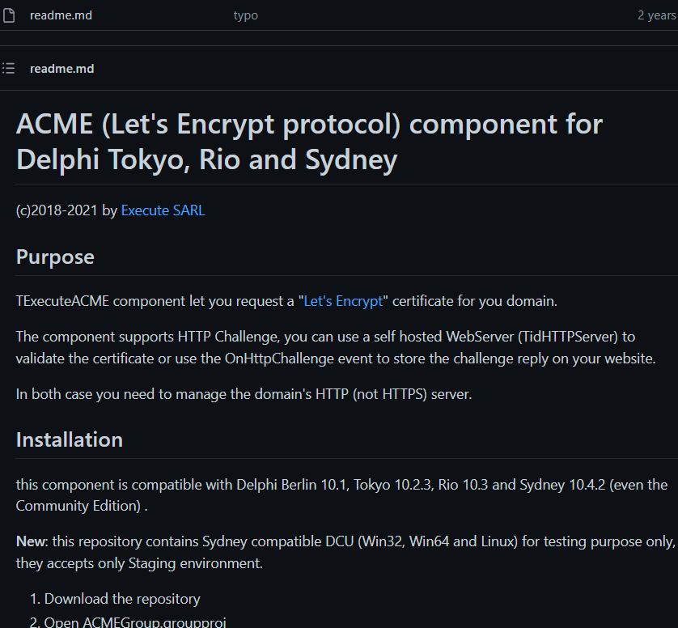
Let’s Encrypt Components
A Delphi component to work with Let’s Encrypt
Written by MVP Paul Toth
https://github.com/tothpaul/DelphiACME

Slide 37
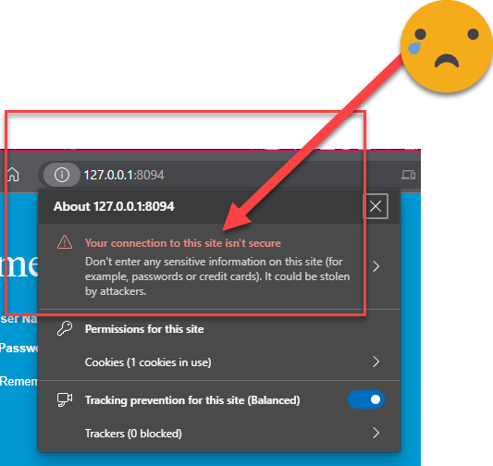

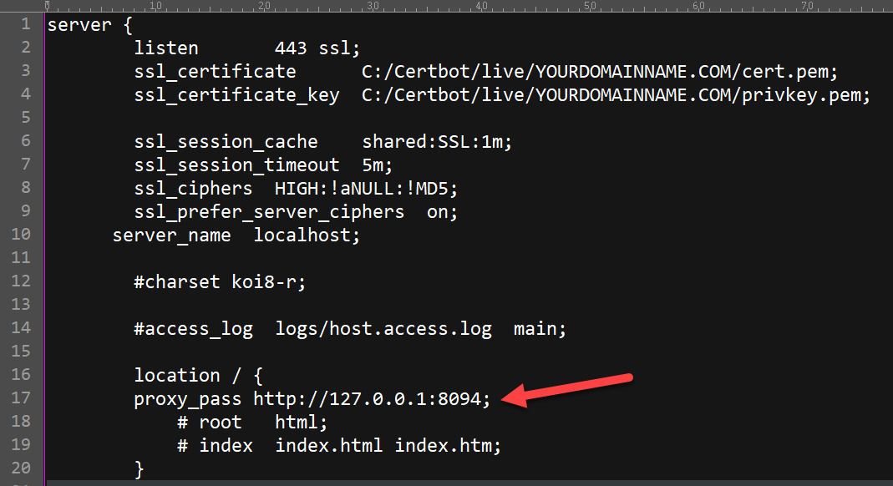
Reverse Proxy via NGinx
If you are using IntraWeb and can’t (or won’t) make the SSL work there is an alternative
https://nginx.org
After you install NGINX, edit the config file as I’ve shown here.
The line with the arrow should be the actual internal non HTTPS URL
All incoming HTTPS traffic will be magically routed to your Intraweb app as plain HTTP and back again outward

Slide 38



…and beyond!
There is NOTHING you can’t do using RAD Studio with Delphi
Run your apps on a Raspberry Pi? There is a solution for that, and it works today.
Run on a cheap Amazon Fire tablet? Target Android – it will run just fine!
Target Windows, macOS (Intel and Arm), iOS, Android, even the web from a SINGLE code base and project? Yes, it’s absolutely a fact
Keep running even after the whole operating system has been upgraded without needing any new downloads or reconfiguration? Yes.
That’s why I choose Delphi

Slide 39

Every app trick in the book
Ian Barker
Embarcadero Delphi MVP
ian.barker@gmail.com
@punctuation
about.me/IanBarker
https://blogs.embarcadero.com/author/ianbarker
Slides, link & replay https://tinyurl.com/everyapptrick

